Slide 1
Investigating Coordination Signals in Multi-Agent Tool-Using Language Models
Auditable actions, synthetic outcomes, and evidence boundaries
Under the guidance of
Dr. Milan Joshi | Faculty - Great Learning
Dhruva N
PES2PGE23DS169

Slide 2
Why success is not the same as coordination
Outcome-only evaluation hides how the work was done
A shared result
A hidden process
A bounded signal
A group can complete a task while members act independently or repeat work.
Success alone does not show which actions changed state or who contributed.
Action traces expose behavior, but do not automatically establish emergence.
Study lens: actions + shared state + stopping outcome, interpreted within the evidence boundary.

Slide 3
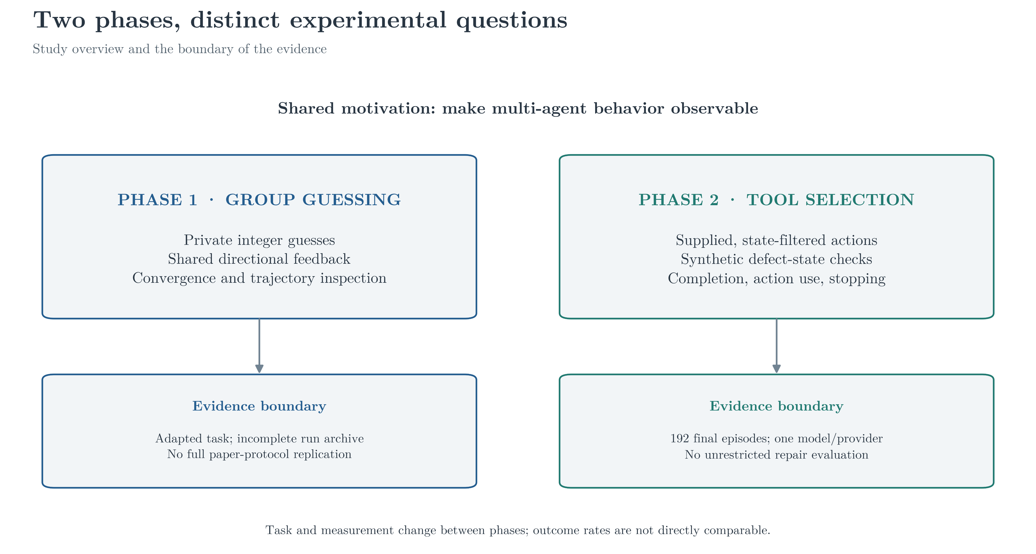
From group guessing to tool use

Slide 4
Three descriptive research questions
Matched assignments organize comparisons; they do not remove all design limits
01 Outcomes
02 Behavior
03 Stopping
How do success, partial, and failure counts differ across matched policies?
How do action volume, tool mix, and nominal actor participation differ?
When do episodes finalize with required work still unresolved?
Contribution: auditable action-to-outcome traces in a controlled synthetic environment.

Slide 5
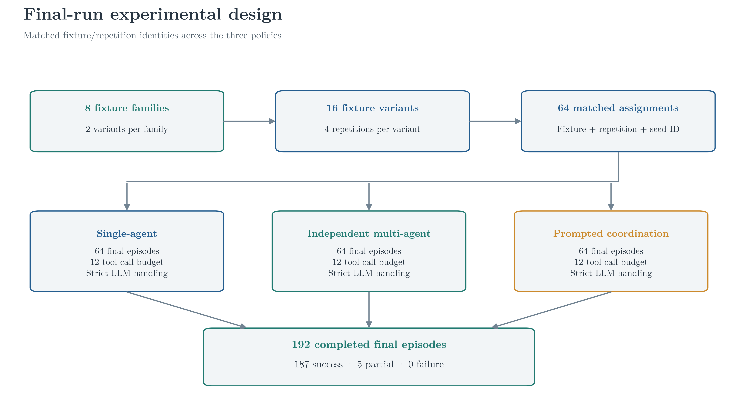
Repeated fixtures support matched policy comparisons

Slide 6
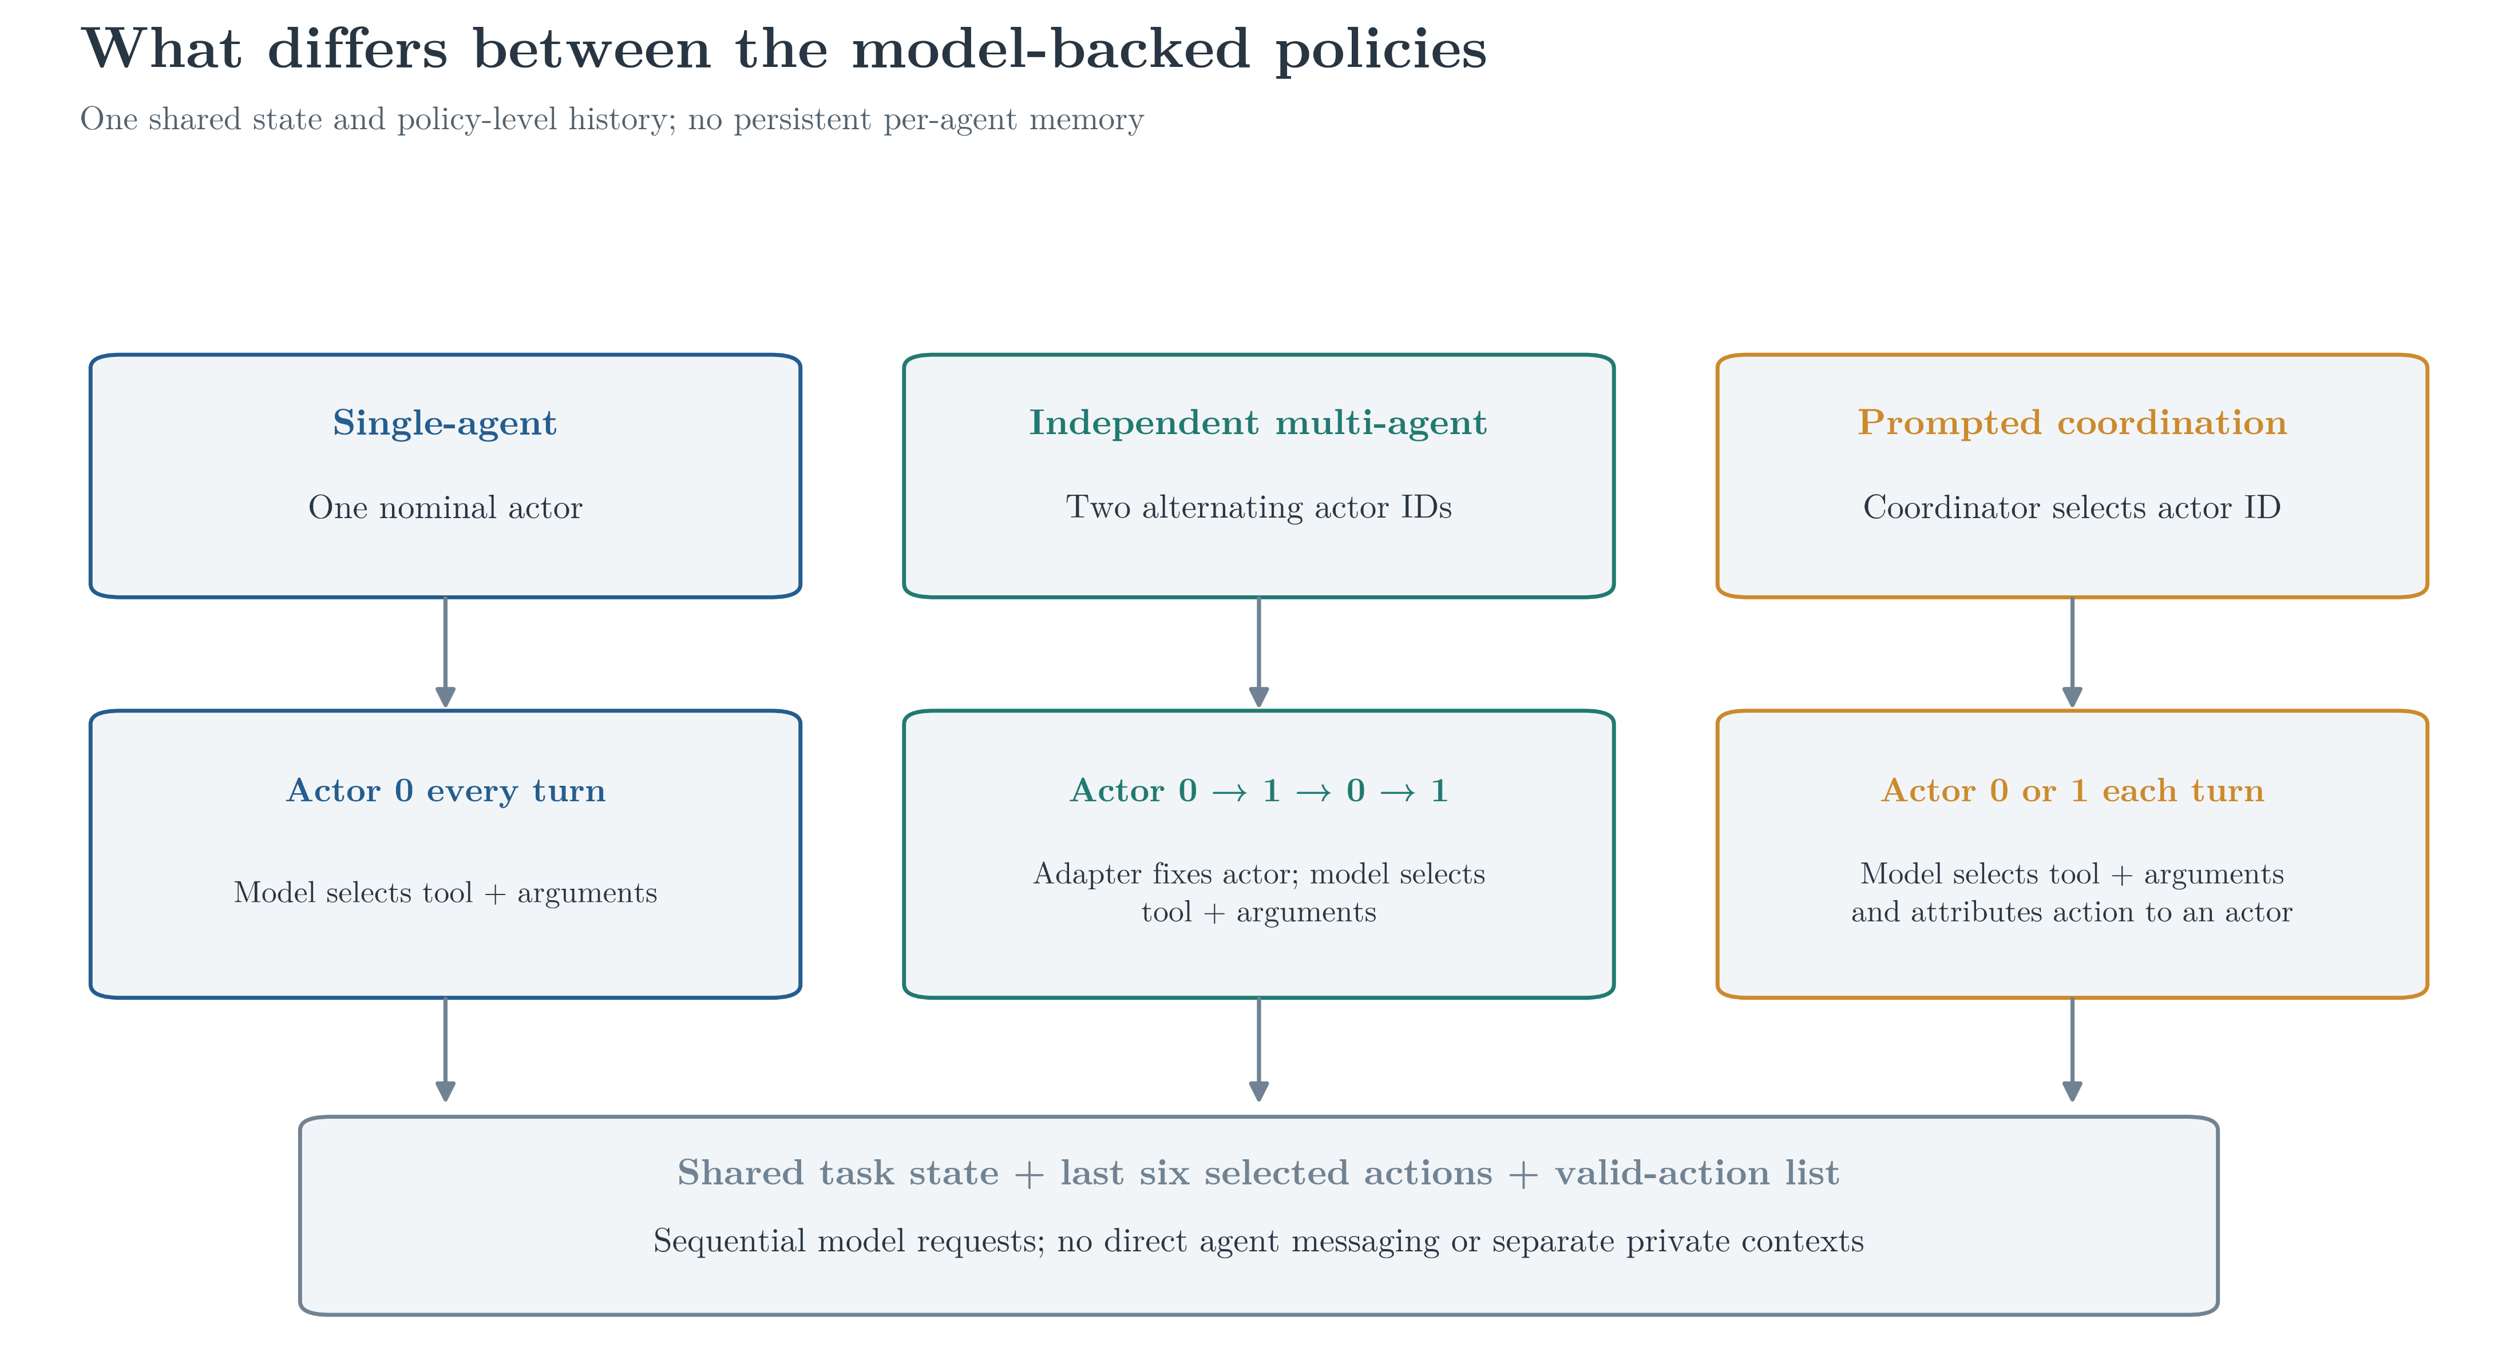
One shared state, different actor-assignment rules

Slide 7
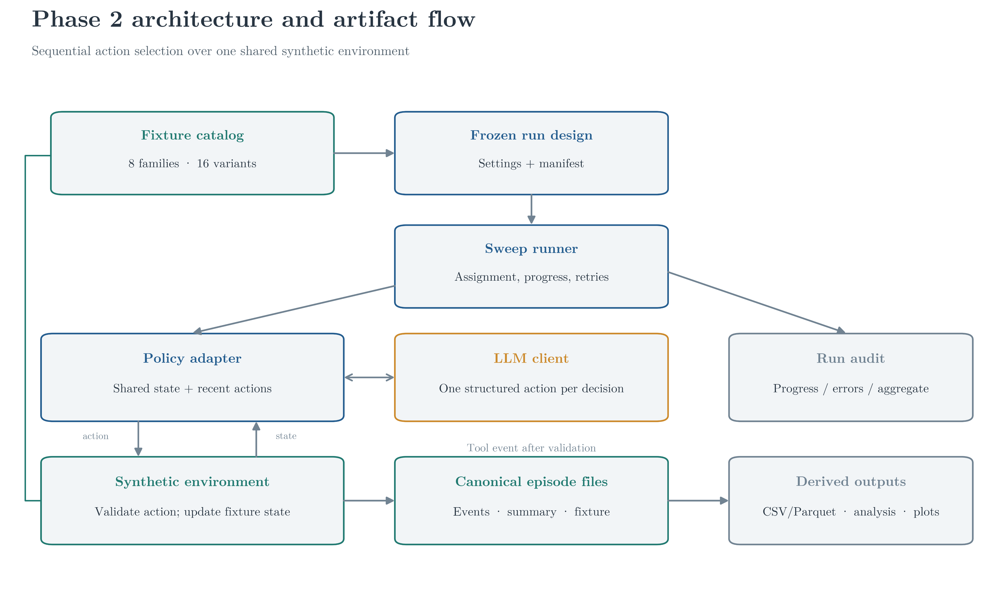
The pipeline links assignments, execution, and audit outputs

Slide 8
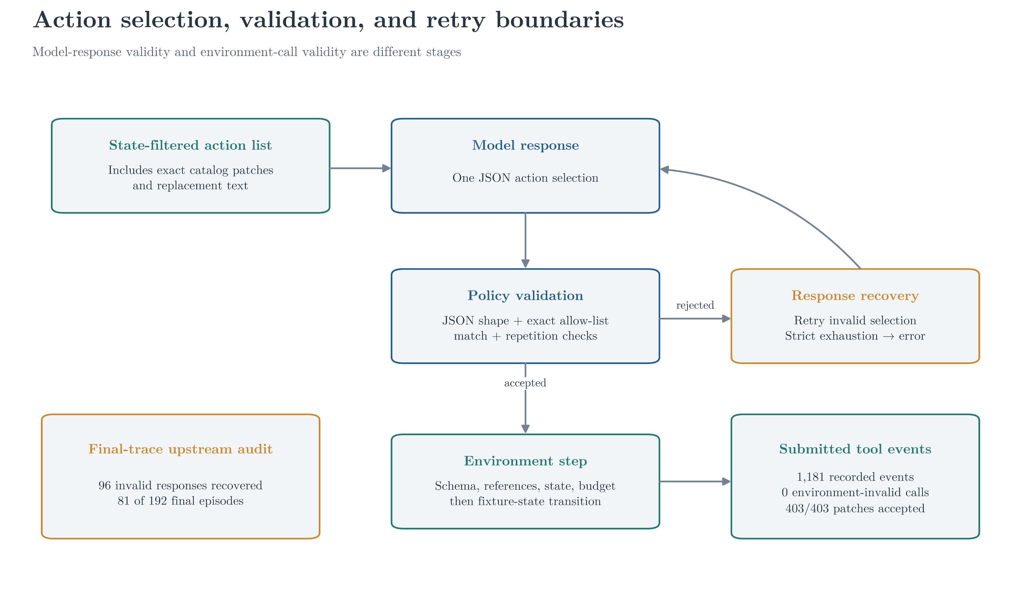
Validation and recovery bound model and tool failures

Slide 9
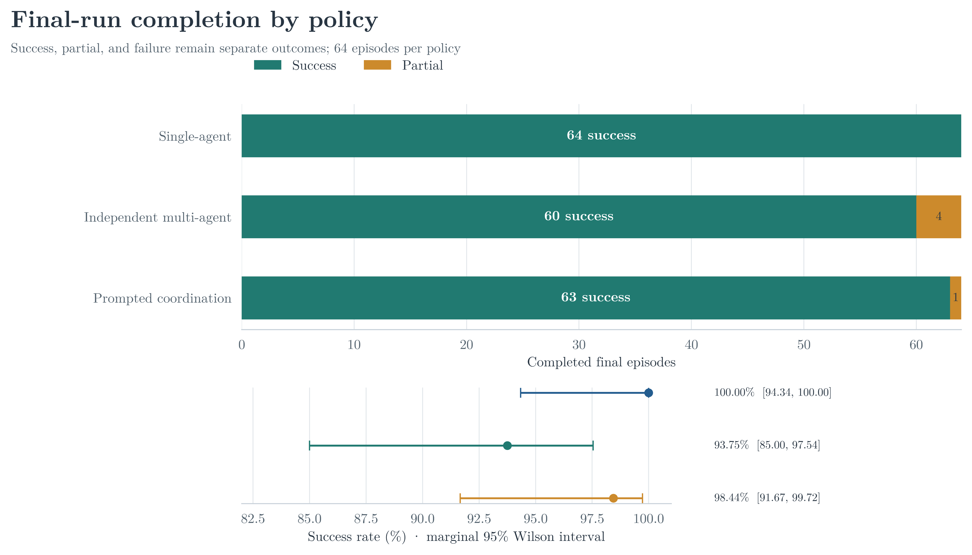
Success dominated, with five partial outcomes

Slide 10
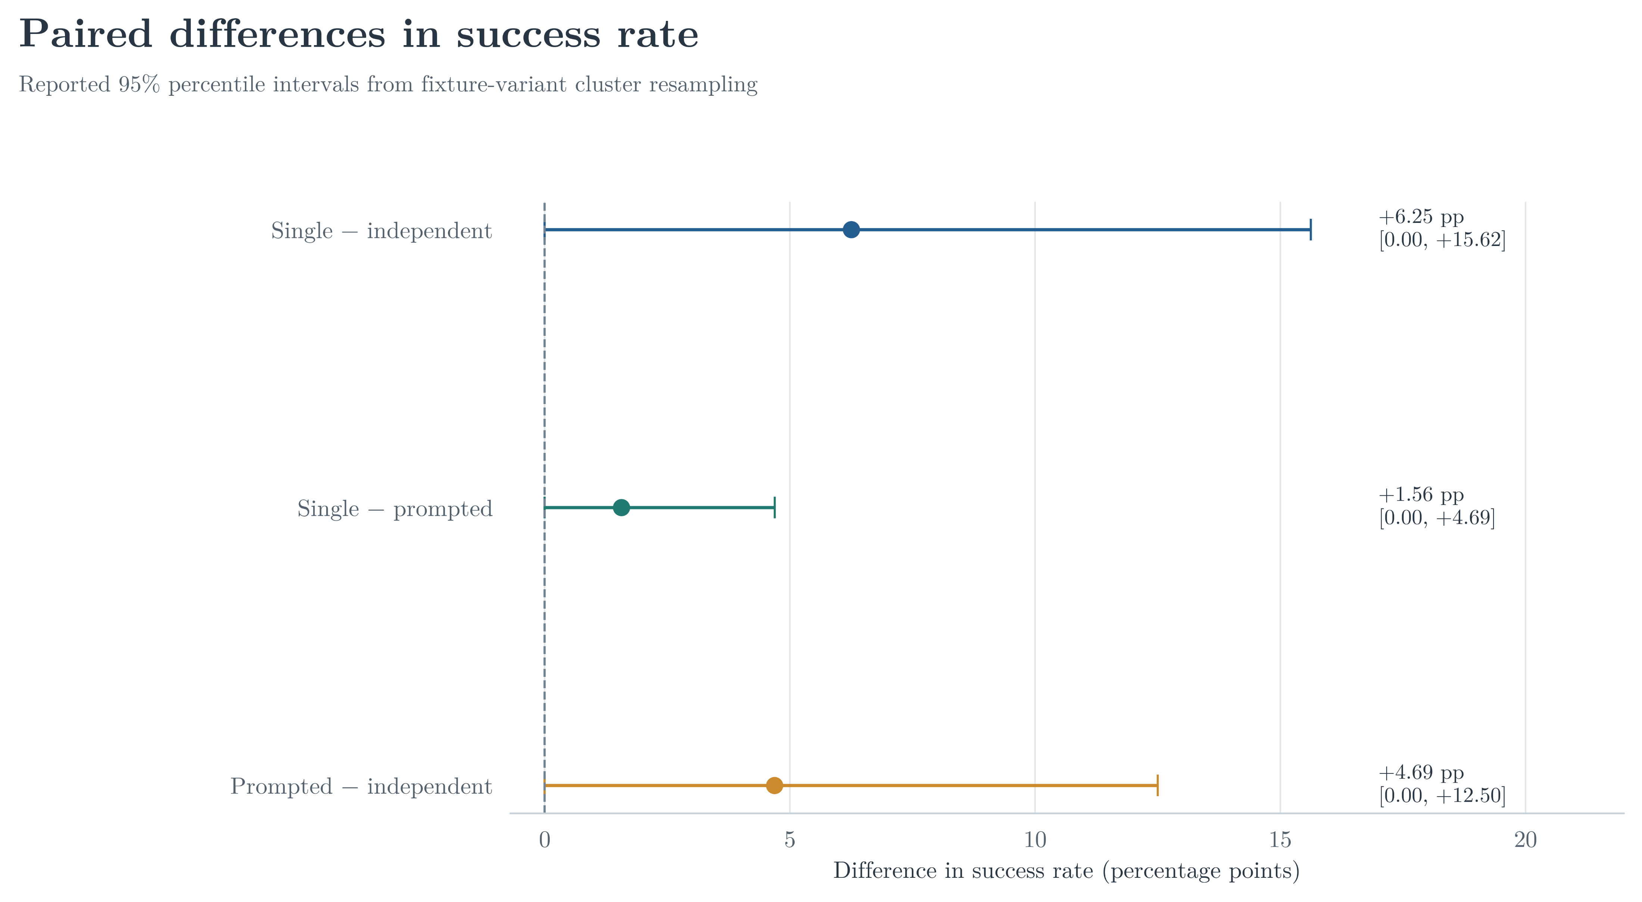
All paired success-rate intervals include zero

Slide 11
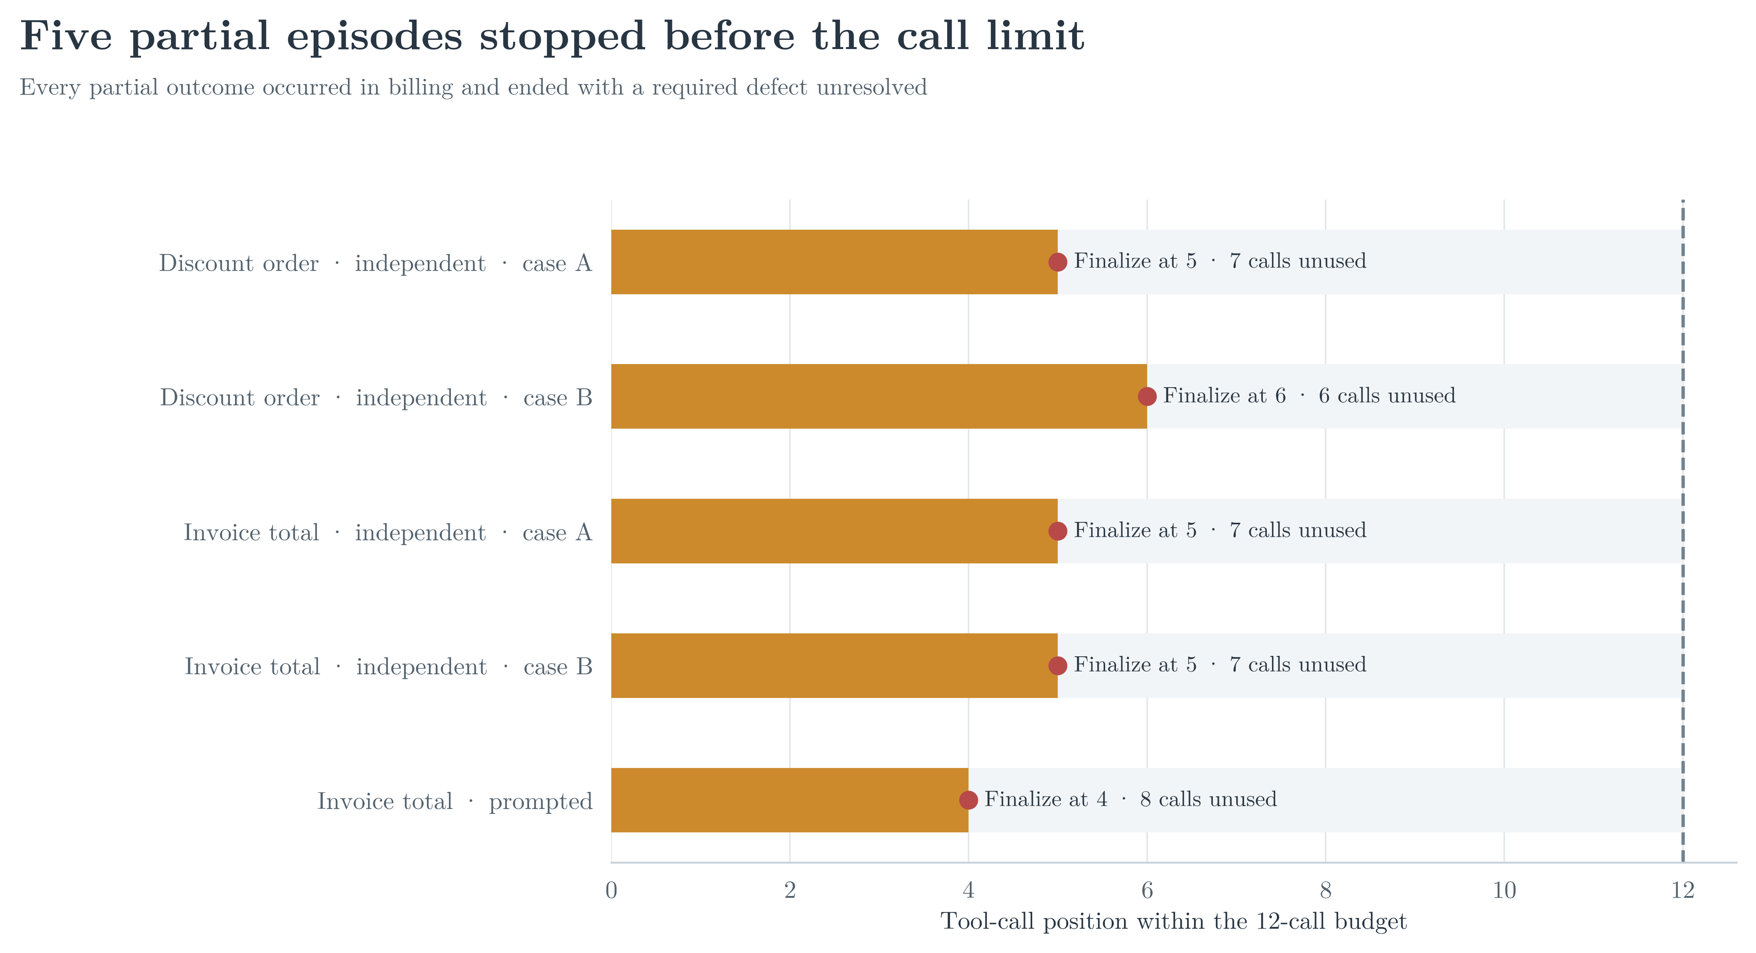
Five episodes finalized with calls remaining

Slide 12
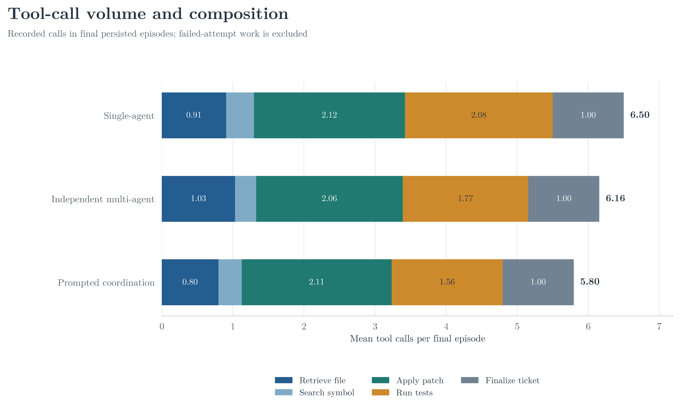
Call totals and tool mix vary by policy

Slide 13
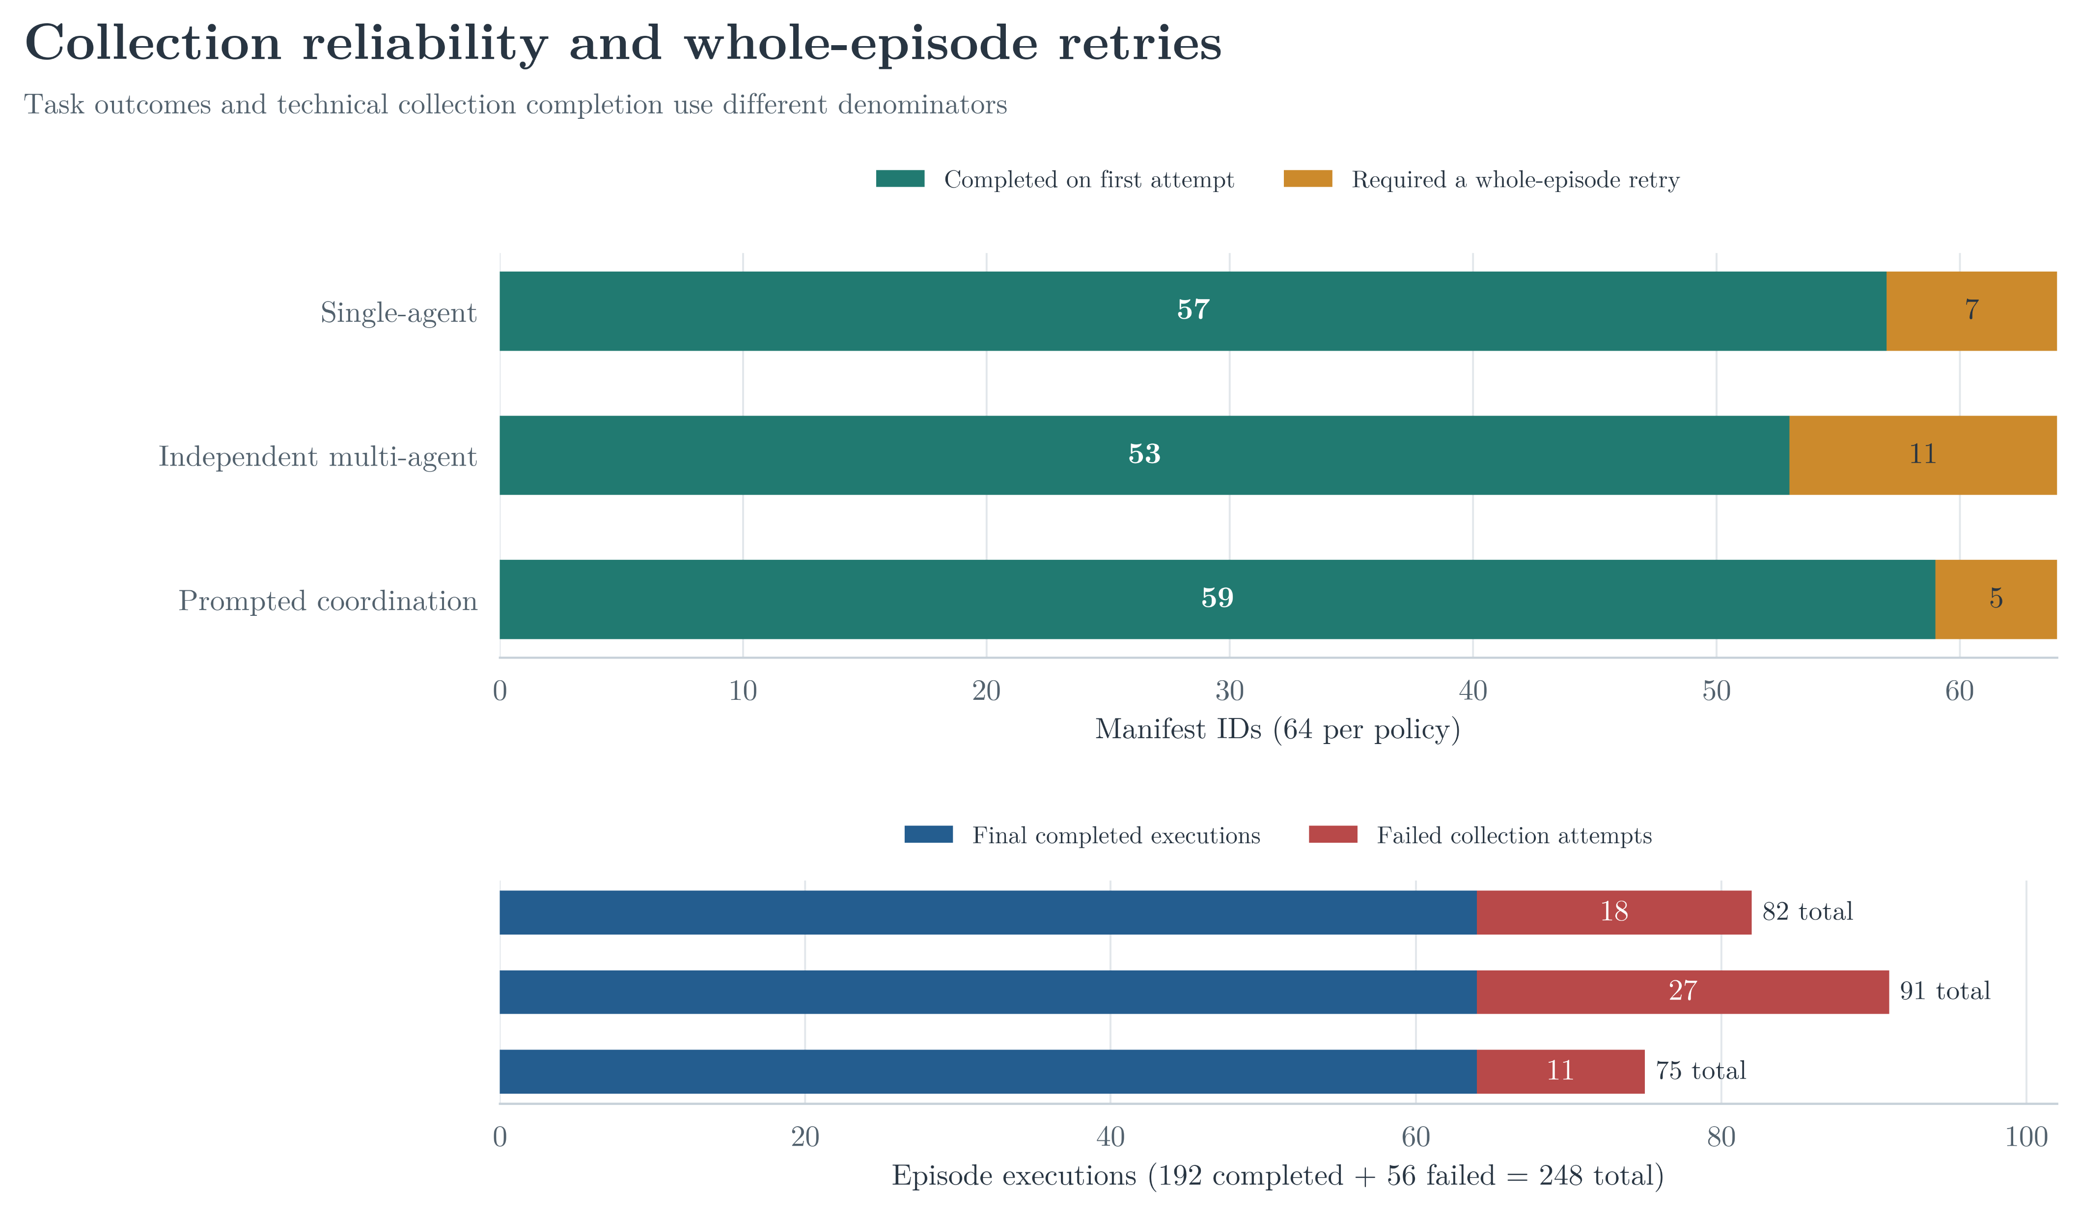
Collection retries are separate from final task outcomes

Slide 14
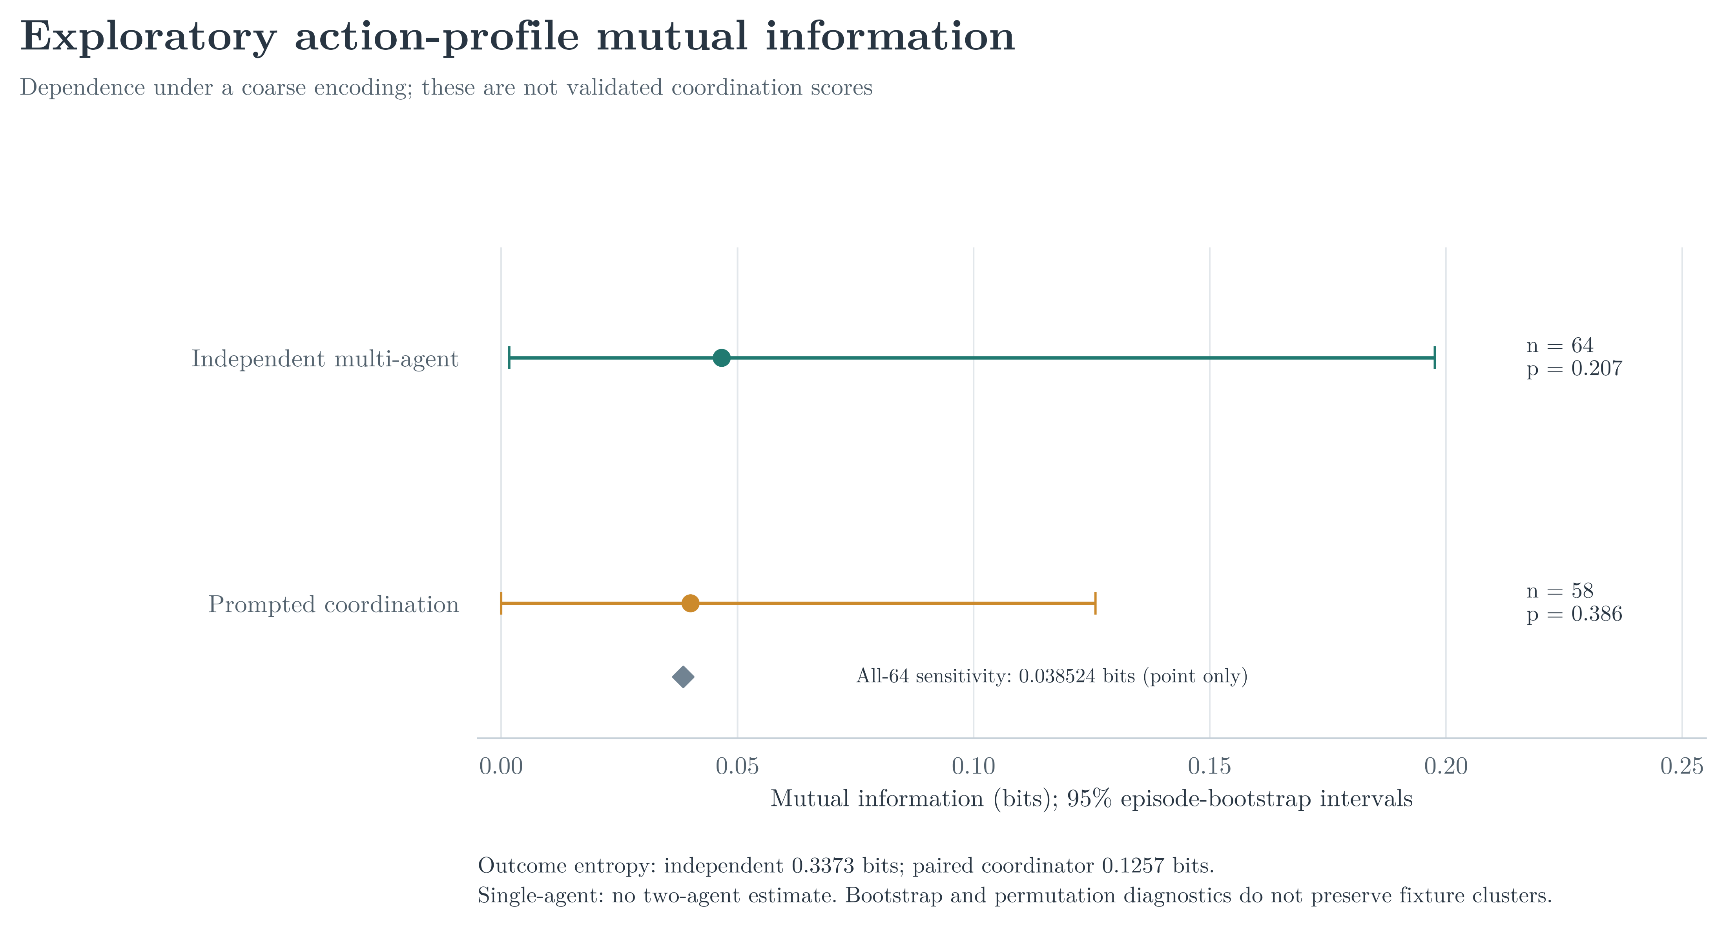
Coarse action labels limit mutual-information claims

Slide 15
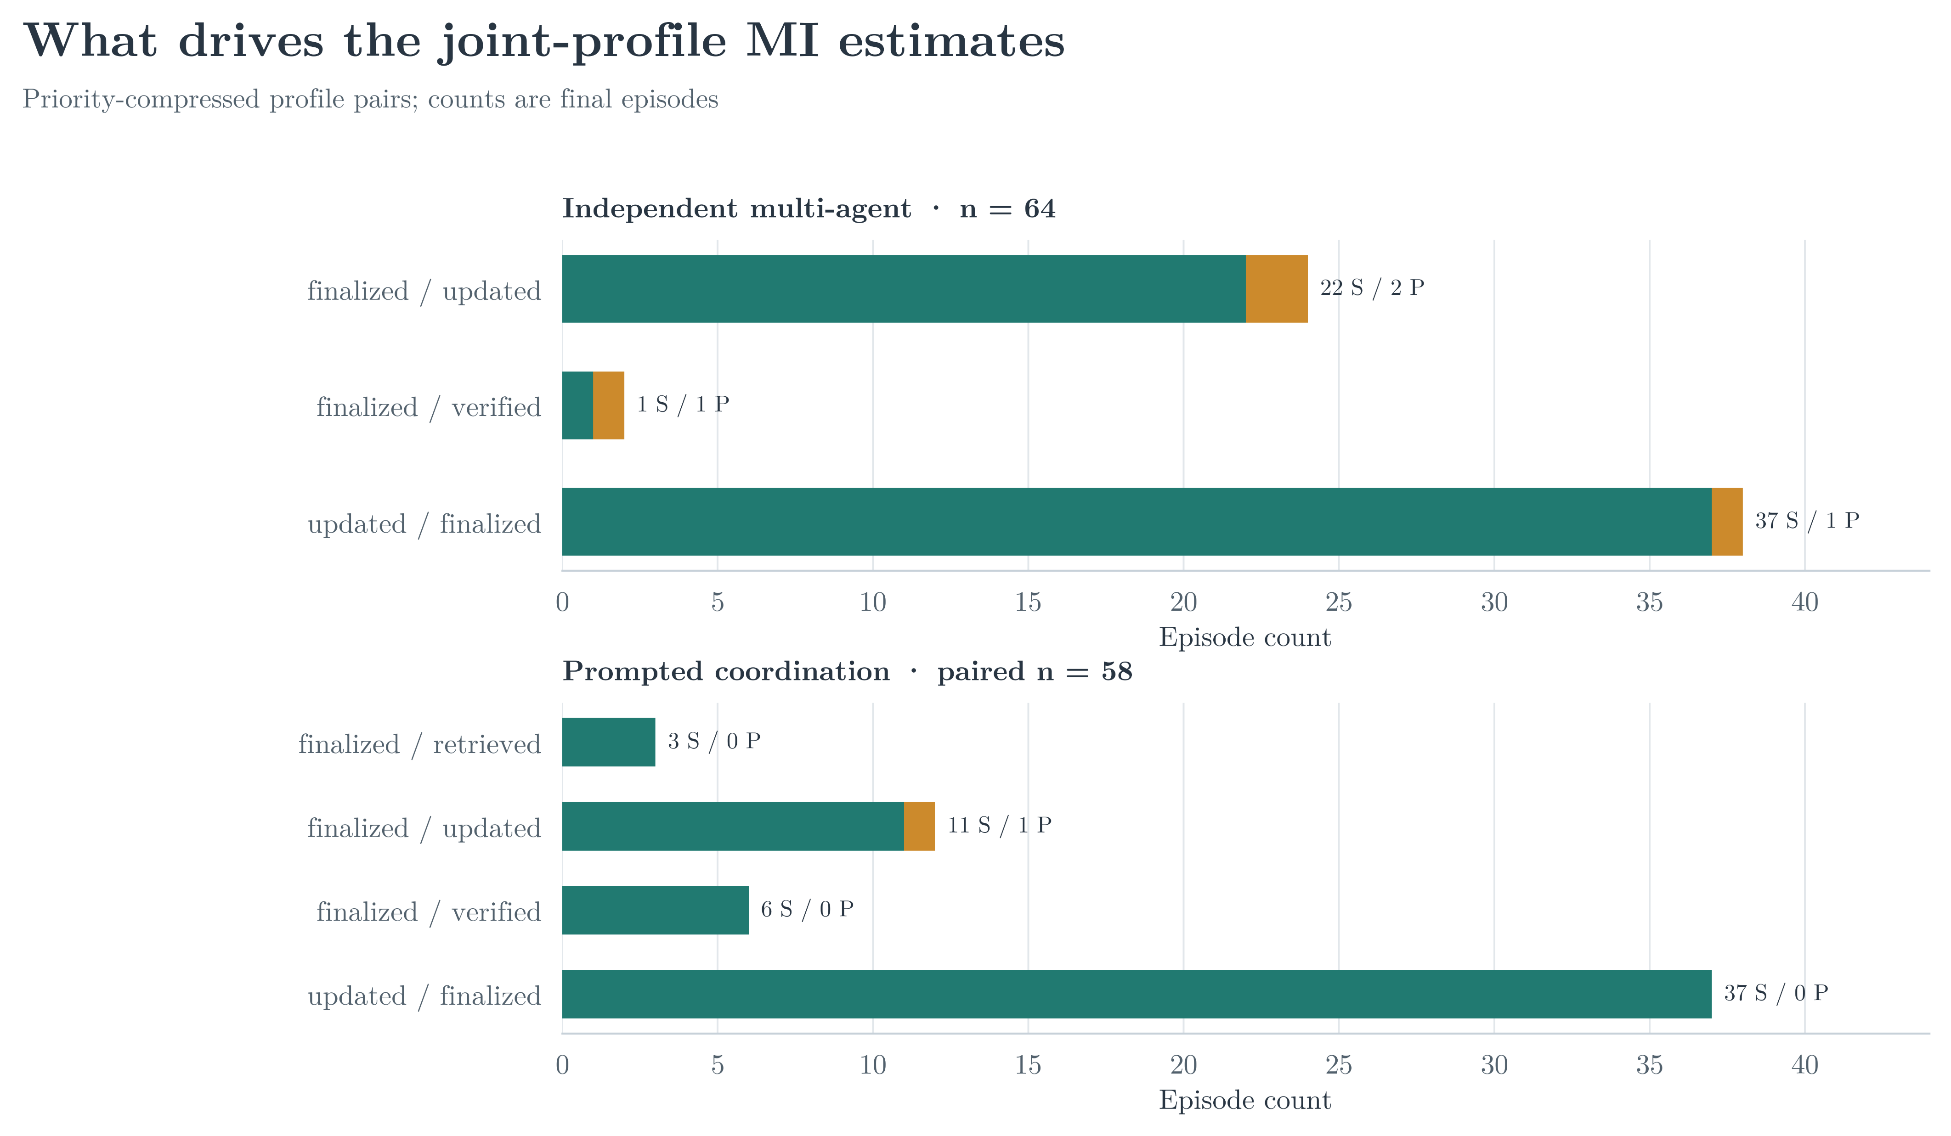
Finalized actions dominate the observed joint profiles

Slide 16
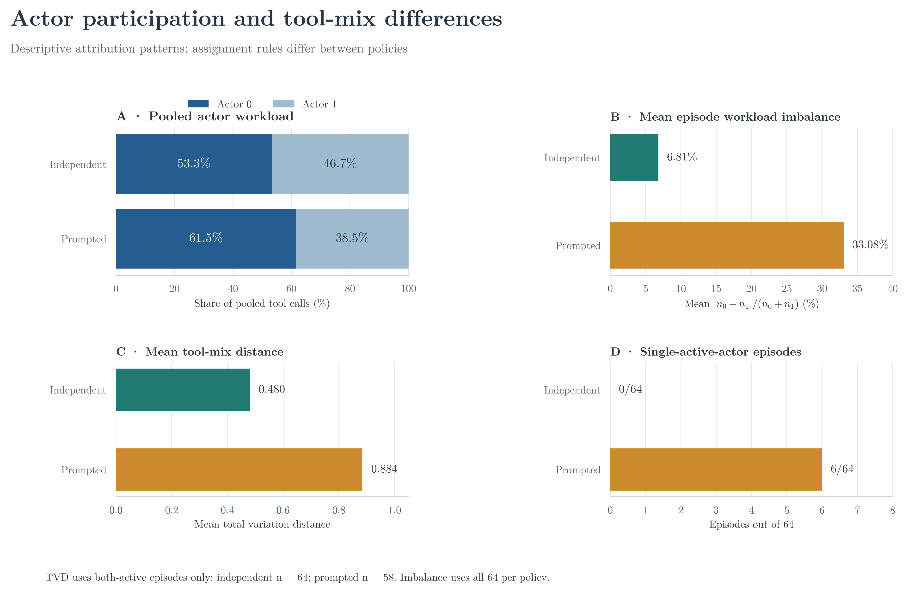
Assignment rules shape nominal participation patterns

Slide 17
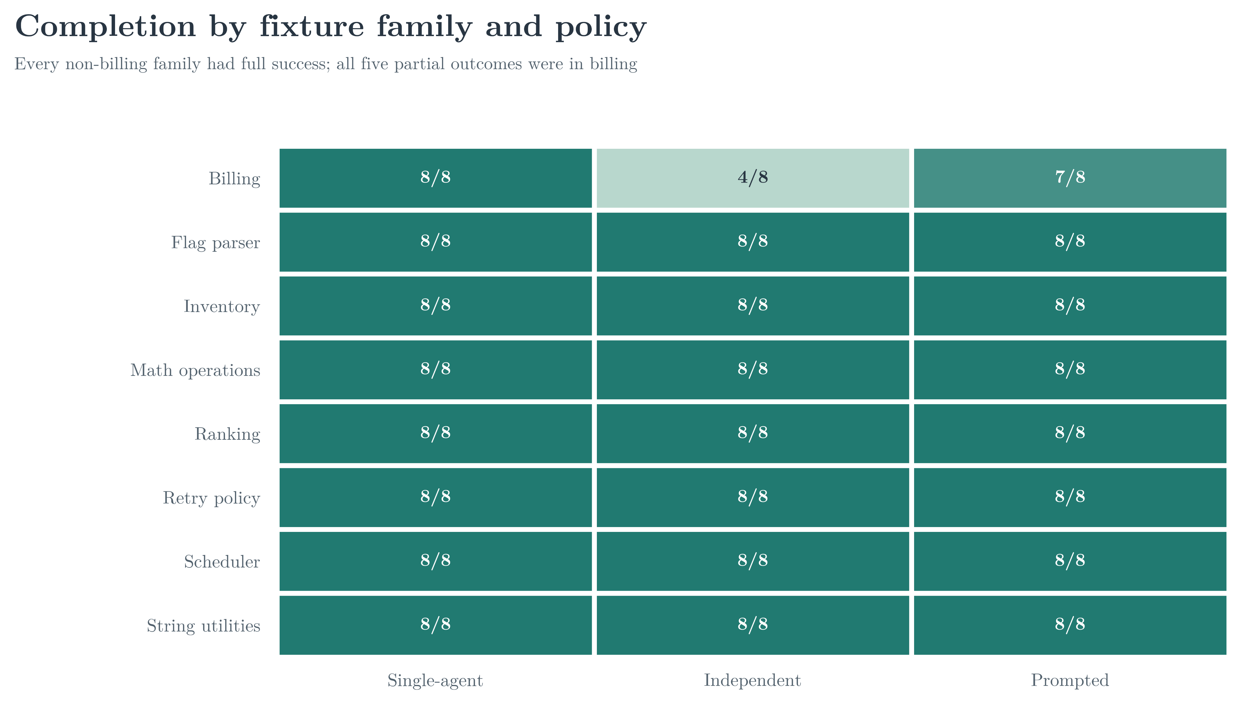
Billing was the only fixture family with partial outcomes

Slide 18
What the evidence supports - and does not
Interpret results within task, model, and action-interface boundaries
Supports
Does not establish
Important limits
Auditable traces; descriptive outcomes; a concrete early-finalization pattern.
Policy superiority, a prompt-only causal effect, or emergent specialization.
One model/provider; synthetic fixtures; supplied patches; tests do not execute code.
The MI statistic is not the motivating paper's temporal information decomposition.

Slide 19
Takeaways and next study
Stronger coordination claims need separable interventions and richer evidence
What we observed
What to test next
192 final traces; 187 successes; 5 partials; 0 failures. Every partial finalized early in billing.
Separate wording from actor assignment; preserve action order; broaden validated task difficulty.
Bottom line: action traces make behavior inspectable; current results remain descriptive and bounded.

Slide 20
Thank You
Questions and discussion?

